Slide 1
A overview of Sentiment Analysis
Haoran Weng
Notes:
Show you a introductory overview of the field of sentiment analysis

Slide 2
Table of contents
1. Defining Sentiment analysis (SA)
2. The growth and topics of interest of SA
3. Main approaches of Sentiment analysis
4. Research Examples and Challenges for SA
5. Some Tools
6. Q&A
Notes:
I will start with the define
Then talk about the recent growth of this field and what topics the researchers are interested in
After that, I will briefly discuss the main approaches
At last, I will talk about 2 examples, and some challenges for sa
Bonus part (show some tools)

Slide 3

What is Sentiment Analysis?
Opinion extraction
Opinion mining
Subjectivity analysis
Consumer Feedback analysis
Notes:
What is
It has many names

Slide 4
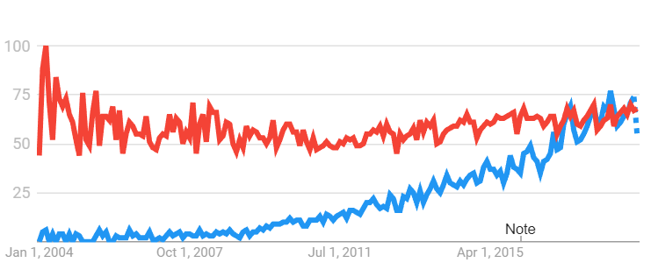
Figure N: Google Trend Comparison between
Customer Feedback vs. Sentiment analysis
Source: Google Trend

Slide 5
What is Sentiment Analysis:
A branch of Text analysis
Study subjective information from people
Opinions & Attitudes
Rapid development since 2004
99% of its academic articles published after 2004 (Mäntylä, Graziotin, and Kuutila, 2017)
Notes:
It FOCUS ON STUDYING subject information from people, which commonly are opinions and attitudes

Slide 6
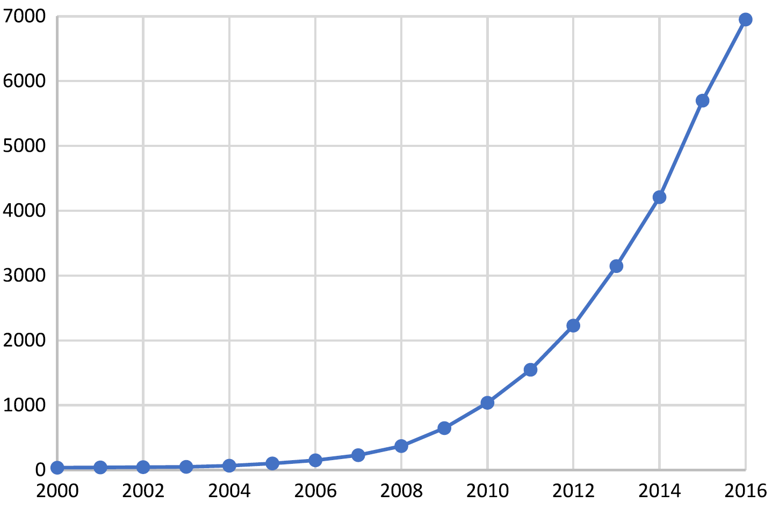
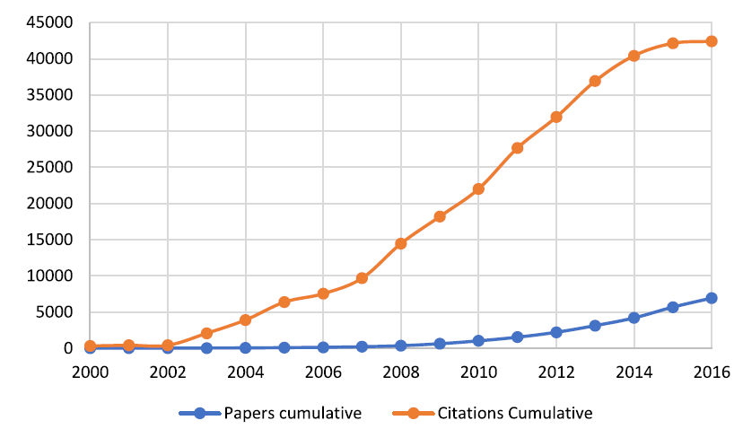
Figure N: Number of papers published per year on Sentiment Analysis
Figure N: Cumulative Number of papers and citation since 2000.
Source: Mäntylä, Graziotin, and Kuutila, 2017

Slide 7
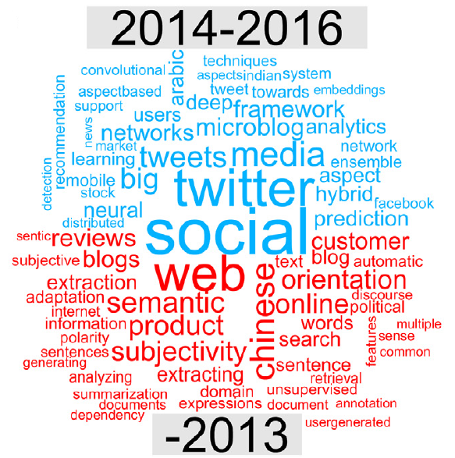
Use cases
Product review
Prediction:
Social media opinion
And more?
Source: Mäntylä, Graziotin, and Kuutila, 2017
Notes:
There are many use cases, such as Product review, election prediction, and social media opinion.
Social -> clearly associated with our social science,
Custormer, prediction, twitter

Slide 8
Topic of interests
Topic of interests
A text analysis of the literatures of sentiment analysis (Mäntylä, Graziotin, and Kuutila, 2017)
Social (Election, policy, school …)
Security (terrorism, crime, crisis …)
Finance (sale, business forecast, stock prices …)
Entertainments (books, movies, games, news …)
Medical (health, suicide, healthcare …)
Etc.
Notes:
Interesting research : put all
In fact the actual range of topics of interests are much wider
It’s

Slide 9
How to do SA?
Three levels of unit of analysis (Fieldman, 2013)
Document level (the simplest form)
The overall sentiment presented in article/ paper
Sentence level (the common form)
Classify a single sentence into negative/positive
Feature-based level (the complicated form)
Classify sentences connected with each other
Differentiate different aspects/feature of the opinion
E.g. A paragraph of movie review: “I like the plot. The performance is great. But the BGM is too annoying.”
Notes:
First we need to clarify our units of analysis.
There are three levels of analysis
Document level analysis is the simplest form.
It’s goal is to extract the overall sentiment presented in
Sentenc
Cohesive meaning
Different aspect: I like the plot, and the performance, but the bgm is too annoying.

Slide 10
Two steps of Sentiment analysis
Data Collection and processing (the text mining part):
-> Get raw text
-> Tokenization
-> Remove stop words
-> Normalization(stemming)
2. Classification (the sentiment analysis part):
Identify subject and object texts (Fact vs. opinion)
Classify positive and negative text (Polarized attitudes)
Notes:
First step
As we have learn in this class, we
And next, the core part of sentiment analysis is classification.
The purpose of many SA research is to build a valide classifer ()
This is a car, that runs fast

Slide 11
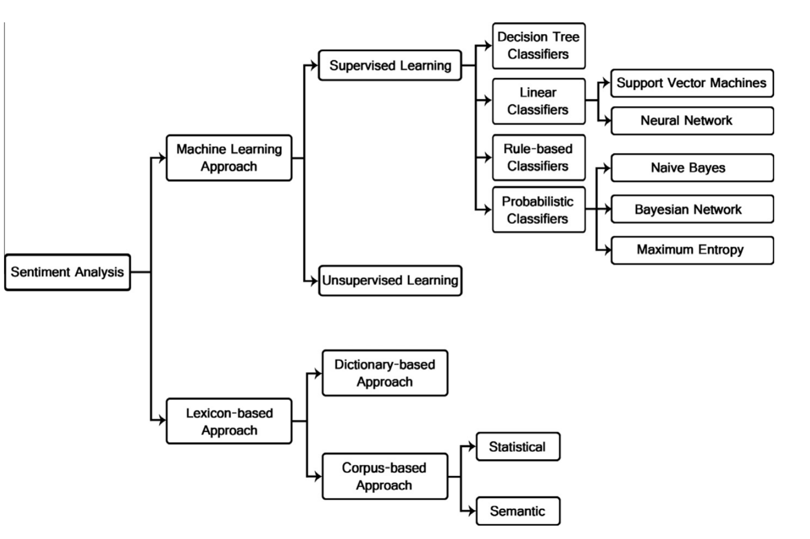
Source: Medhat, Hassan, & Korasky, 2013
Notes:
There are two main stem of sentiment analysis approaches
A and b
They are future divided into more specific categories

Slide 12
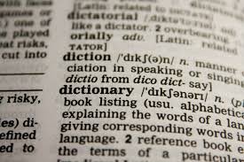

Methodological approaches of SA
Lexicon Based Approach (Feldman, 2013)
Manual Approach (humans do the hard work)
Dictionary-based approach (Single dictionary)
Corpus-based approach (Specific dictionary for a domain/field)

Slide 13

Methodological approaches of SA
Machine learning approach
Supervised learning
Support vector machines (Linear regression)
Naïve Bayes (Probabilistic)
Maximum Entropy (Probabilistic)
Unsupervised Learning
Require pre-existing information for classification (Labeled training set)
Clustering analysis

Slide 14
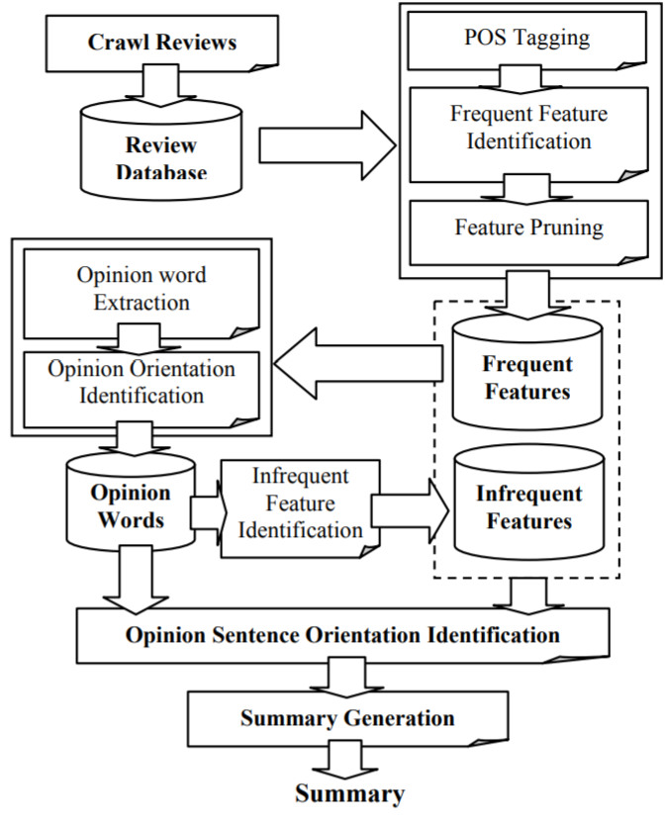
Research Examples
“Mining and Summarizing Customer Reviews” by Hu, & Liu (2004)
Early work of Bing Liu, the most cited researcher in this field.
Feature based lexicon approach
Study the customer feedback on a
set of electronic products sold online.
WordNet (lexicon)
Accuracy 73% - 95% for different
products

Slide 15
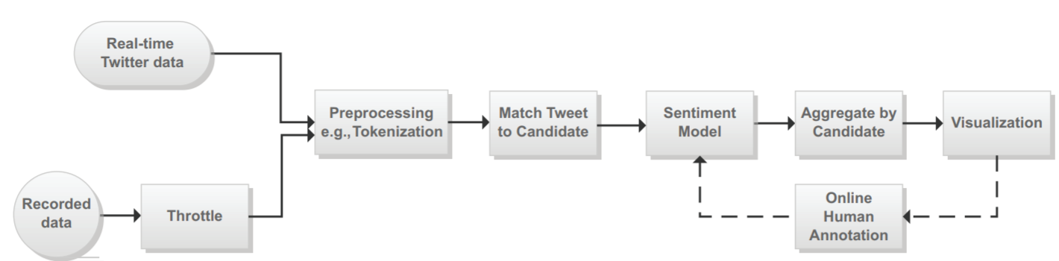
Research Examples
“A System for Real-time Twitter Sentiment Analysis of 2012 U.S. Presidential Election Cycle” by Wang, et al. (2012)
Naïve Bayes classifier (human rated tweets as priors)
Real time evaluation of tweets related to election candidates.
Source: (Wang, et al, 2013)

Slide 16
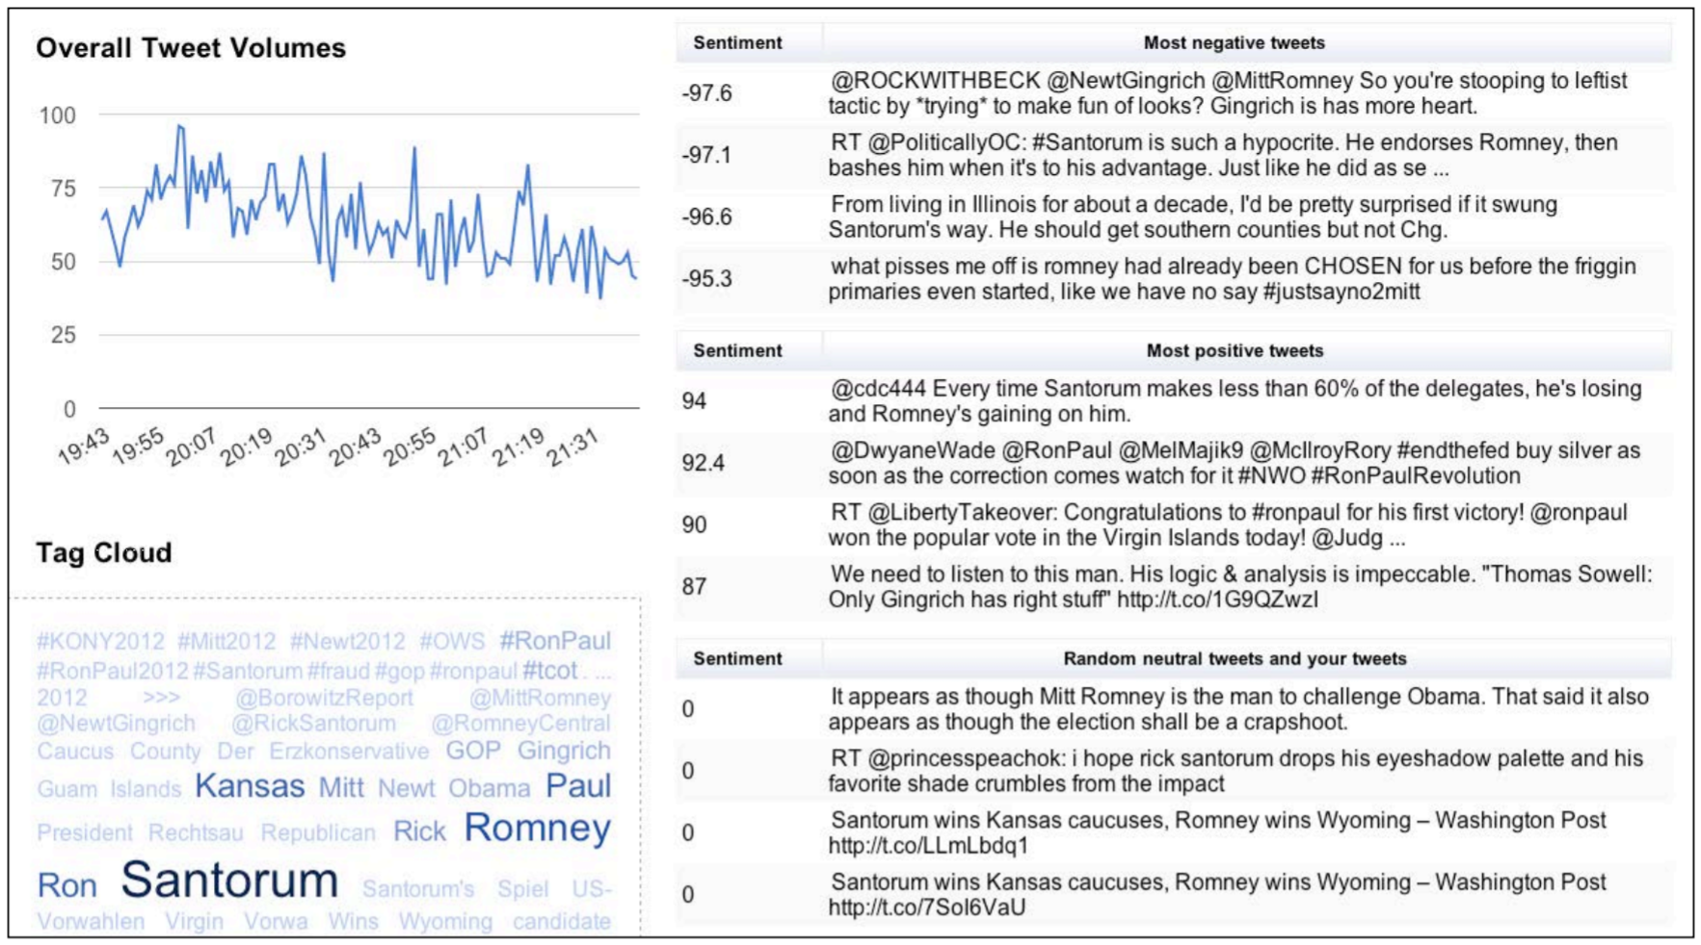
Source: (Wang, et al, 2013)

Slide 17
Challenges
Subjectivity of emotional words
(20%-30% discrepancy in human interperation)
Interrogative sentence (Can it be good?)
Sarcastic Sentences
Expression without sentiment word
Conditional sentence (E.g. The vacuum cleaner sucks.)
Problem of understanding point. (International oil price increases.)
Spam and robot posts
(Pradhan, Vala, & Balani, 2016)
Notes:
2

Slide 18

Tools for Sentiment Analysis
For data
API for social media/ Customer Review
Web scraping
Web crawlers
(R/Python programming, TwitteR Getoldtweets)

Slide 19

Tools for Sentiment Analysis
For analysis:
For customized in-depth research
R or Python Programming
(Natural language toolkits)
For exploratory easy study:
- Sentiment Viz (online Tweet Sentiment Visualization)
- Socialmention.com (online topic-level sentiment analysis of social media posts)

Slide 20
References:
Fieldman, Ronen, 2013, Technique and Applications for Sentiment analysis, Communications of the ACM, Volume 56 Issue 4, April 2013, Pages 82-89
Hao Wang , Dogan Can , Abe Kazemzadeh , François Bar , Shrikanth Narayanan, A system for real-time Twitter sentiment analysis of 2012 U.S. presidential election cycle, Proceedings of the ACL 2012 System Demonstrations, p.115-120, July 10-10, 2012, Jeju Island, Korea
Mäntylä, Graziotin, & Kuutila, 2017, The evolution of sentiment analysis—A review of research topics, venues, and top cited papers, Computer Science Review 27 (2018) 16–32.
M. Hu and B. Liu. Mining and summarizing customer reviews. In KDD ’04, pages 168–177
Medhat et al., 2014 W. Medhat, H. Hassan, H. Korashy, Sentiment analysis algorithms and applications: a survey, Ain Shams Engineering Journal, 5 (4) pp. 1093-1113
Pradhan, Vala, & Balani, 2016 A Survey on Sentiment Analysis Algorithms for Opinion Mining, Mining, International Journal of Computer Applications, Volume 133 – No.9

